Slide 1

CATER ME
UNHUNGRY YOURSELF!

Slide 2

THE PROBLEM.
All colleges in India right now have a mess or a canteen and require some sort of Catering Service in order for it to function.
The problem revolves around the fact that the colleges find it difficult to arrange new caterers for their canteens every year since they need to take into account the factors of cleanliness,prices and timings.

Slide 3



THE SOLUTION
We aim to provide both the sides of the problem with a simple interface which would allow them to COMMUNICATE with each other.
Keeping in mind that catering requires more physical labour, we are sure that people of that mindset are available in plenty and so it would lead to EMPLOYMENT.
NETWORK OF CATERERS is another thing that we would give rise to. The network here implies that now colleges and caterers will have the flexibility to choose whom they want.

Slide 4
THE SOLUTION
TIME COMPLEXITY is another issue that will be resolved when this idea is implemented. Until now the manual method to be used is that colleges need to look for caterers by calling them and then negotiating with them for various reasons and this drill continues for days or even weeks until they find the perfect caterer.
This in turn will also help the LOCAL CATERERS to flourish since they would get an option to choose from a variety of colleges and institutions and would also be able to know about newer opportunities.

Slide 5
This would eventually lead to an increase in food quality around the colleges of India because of the ratings that colleges will give to them after their tenure and the competition amongst the caterers would lead to a decrease in the prices as well. This is also going to increase student satisfaction.
HOW WILL THIS HELP THE COLLEGES?

Slide 6

OLD REVENUE MODEL
The way the whole revenue mechanism works as of now is :
STEP 1 : The institute releases tenders and then the caterer would offer the Institute a certain amount of money which generally revolves around 3,00,000 INR for a period of one year.
STEP 2 : This sum includes the total rent of the land for the entire tenure.
STEP 3 : The college earns a part from the rent it is paid by the Caterer and the Caterer earns through the sales it makes in the Canteen/Mess.

Slide 7
NEW REVENUE MODEL*
The way the revenue mechanism will work now :
STEP 1 : We ask the college to pay us a membership fee of 1 Lakh (out of which 50k will be ours and the rest amount will be invested in the cleaning and maintenance of the Area) and that would include the following services :
Free Renovation in the beginning of the tenure.
Cleaning of the entire Mess/Canteen Area for the entire tenure.
Certificates making sure that the entire Process is Legal.
A monthly revenue (About 8-10%) based on the total sales of the Canteen which would be done with the approval of the Catering Service.
STEP 2 : The Catering Service( which earlier used to pay a sum of 3 lakhs) will pay us 1.5 lakhs thus making sure that they are compelled to work with us (out of which 20k will be ours and 1.3 lakhs will be given to the college as the rent for the land).
STEP 3 : Out of the monthly revenue we will keep 5% for ourselves as well.
* for a period of one year

Slide 8
Let's say on an average each plate in the mess costs the caterer 50 INR.
Considering that in a day it makes a sale of 100 plates ( which it easily does)
the revenue generated for a day is = 5000 INR
3. Revenue generated in an entire month = 5000 * 30 = 1,50,000 INR
4 10% of the 1,50,000 = 15,000 INR. Taken for a year that totals 1,80,000 INR
5. Adding to what the college already had ( 1.3 lakhs) that makes a total of 3.10 Lakhs (Which is what the college was already earning that to without all the services we will provide it now).
6. 5% of 1,50,000 INR = 7,500 INR. which totalled for a year makes 90k INR.
7. Now the caterers are still left with a monthly sum of 1,27,500 INR which totalled for an entire year makes 15.30 Lakhs.
Let's do some Math!*
*Worst case scenario

Slide 9
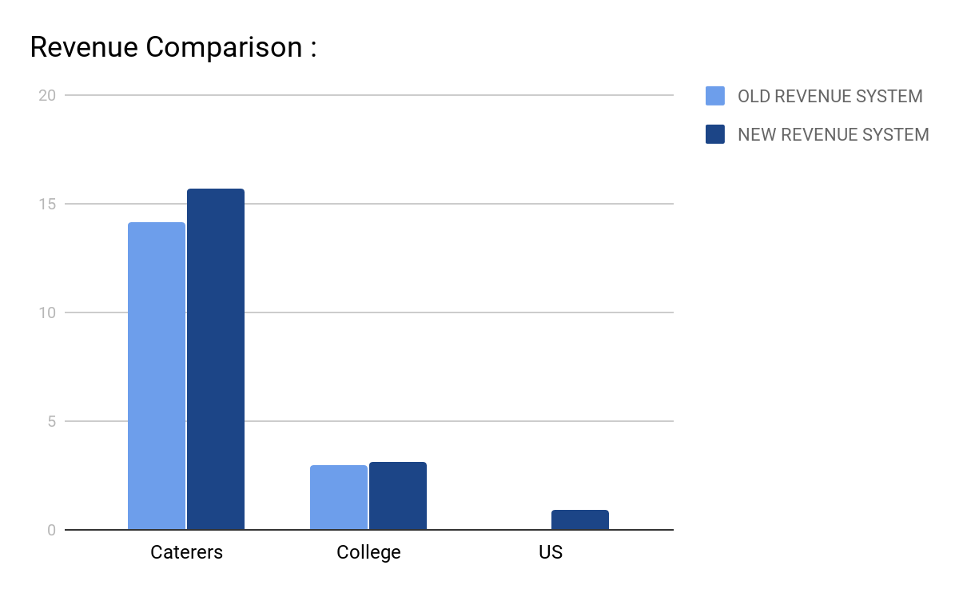

Slide 10

According to posist.com , the food service business in India is worth over 3.09 lakh crore rupees (in 2016) and is subjected to grow at a CAGR of 10% over the next 5 years to reach 5.52 lakh crore by the year 2022.
Market Value

Slide 11

WORKFLOW
FOR THE INSTITUTION :
The institute will sign up on the website which will include details :
Name of institute
Location
Total strength (students and staff)
Everyday Hostel requirements (if any)
Food preferences (can be edited for future)

Slide 12

WORKFLOW
FOR THE CATERERS : The caterers will be asked to submit the following details :
Name
Address
ID Proof (Aadhaar card, Voter ID,etc)

Slide 13

If any caterer completes its tenure then it will be verified on the website so that the institutes know that the Caterer is Verified.

Slide 14
THANK YOU!
An idea for HACKINIT BPIT 2019
BY:
Parth Sikka
Abhishek Mishra
Shelly Garg
Vaibhav

